Slide 1
Upload/Download parameters from DSS

Slide 2

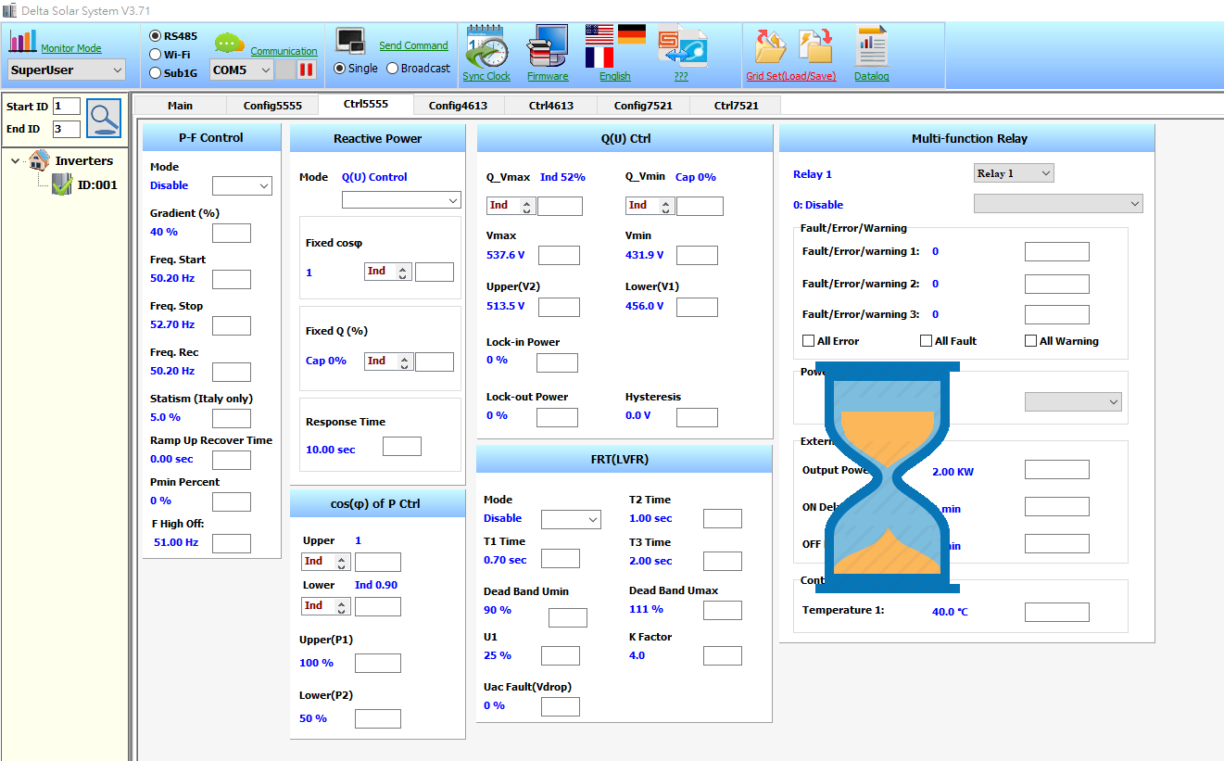
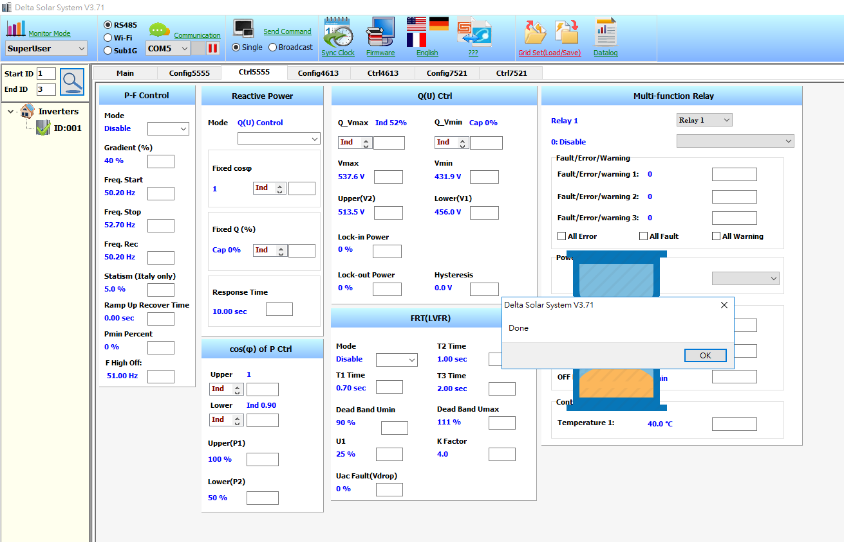
Grid set (Save)
User need to create a excel file by following procedure.
Click Save icon(red frame) on the top of DSS to Save the setting values from DSS.
Wait for DSS saving the parameter to the excel file.
After DSS shows “Done” means the file has already create.
Click “OK” to finish.
need access by Password 4613

Slide 3
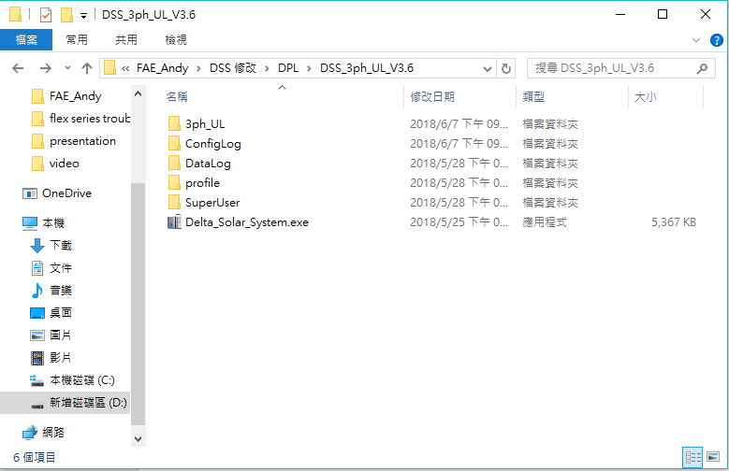
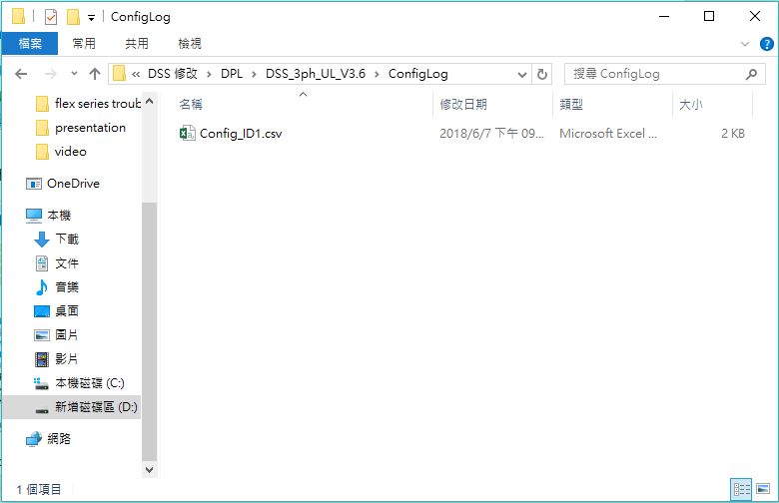
Grid set (Save)
The file will be save in “ConfigLog” folder which is in DSS folder.

Slide 4
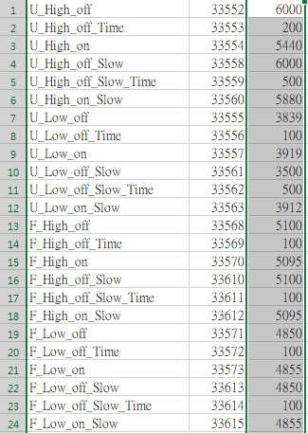
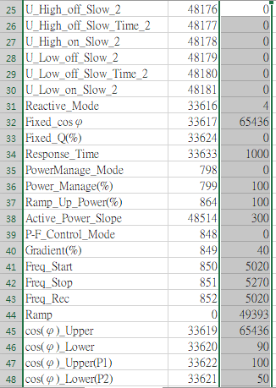
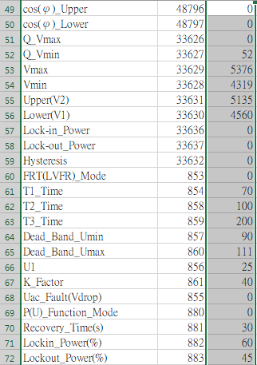
Excel file
User can edit the parameters from excel file which located in “ConfigLog” folder
Support : Grid setting, reactive power, active power, Q(V) P(V) cos-phi(P) LVRT.
After edit the value, remember save the excel file then follow next slide to upload the parameters.
.

Slide 5
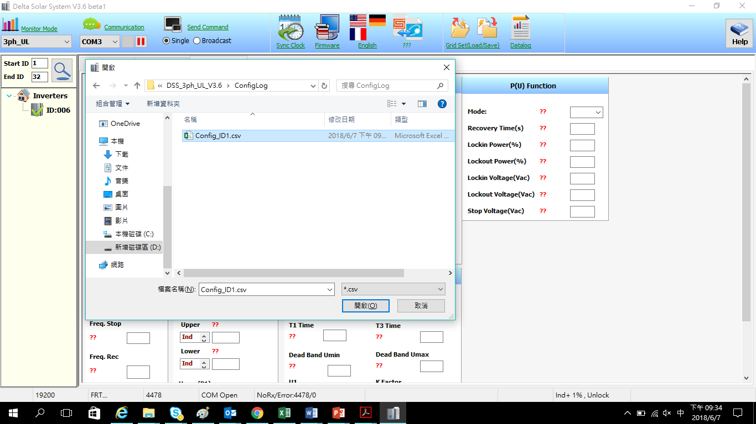
Grid set(Load)
Click Load icon(red frame) on the top of DSS to load the setting values from DSS.
Choose the file that user just edit.

Slide 6
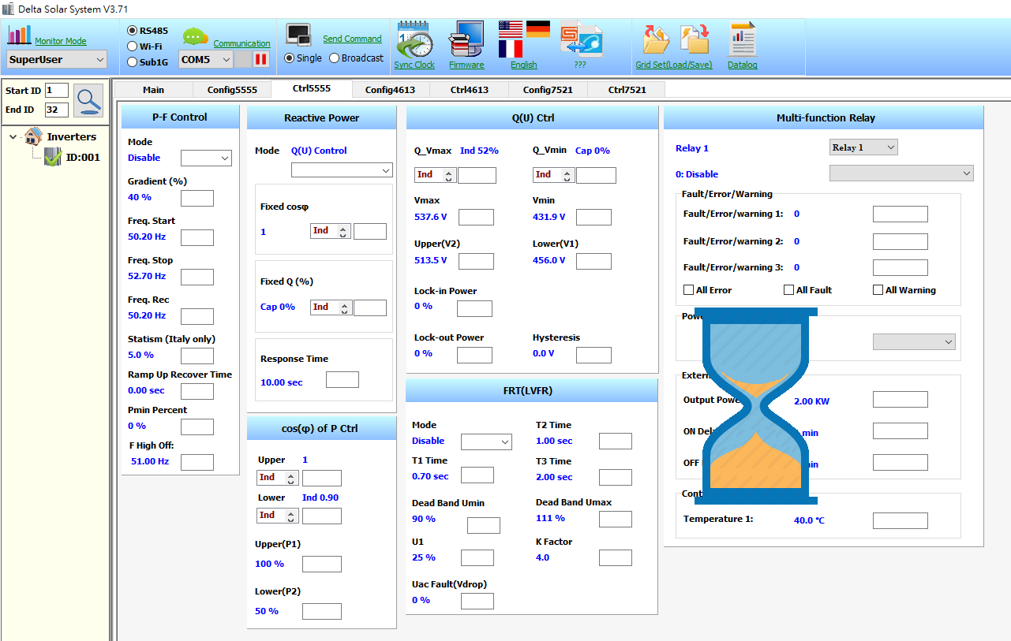
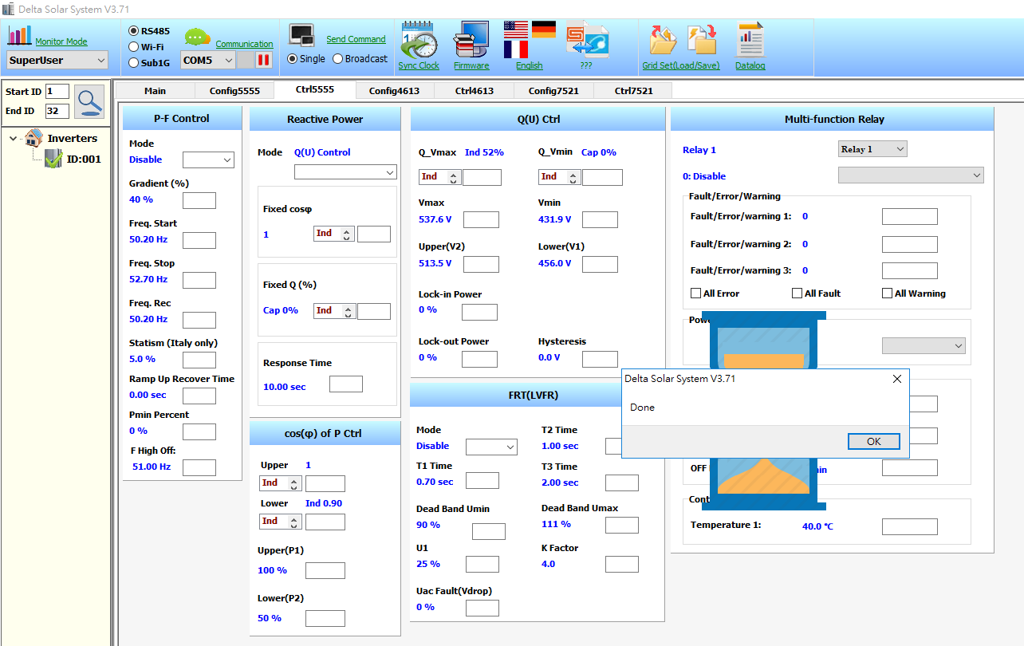
Grid set(Load)
Wait for DSS loading the parameter from the excel file.
After DSS shows “Done” means the parameter has been upload.
Click “OK” to finish.

